Slide 1
Exploratory Data Analysis of Amazon Bestsellers.
.

Slide 2
Introduction
A comprehensive Exploratory Data Analysis (EDA) performed on a dataset of Amazon bestseller items from various international marketplaces. The primary goal of this project is to uncover the key factors that drive product success on Amazon's bestseller lists, including pricing strategies, customer satisfaction (ratings), and market distribution. By leveraging PySpark for efficient data processing and diverse visualization techniques, we aim to transform raw data into actionable insights, providing a clear picture of e-commerce performance dynamics.

Slide 3
Technologies Used
PySpark (Apache Spark) - CSV loading, schema inference, data cleaning (regex_replace, cast), data aggregation (mean, count).
Pandas - Converting the final, cleaned PySpark DataFrame into a local Pandas DataFrame for plotting.
Matplotlib - Handling the core visualization framework, figure generation, and plot customization.
Seaborn - Generating complex, publication-quality statistical charts (e.g., ECDF, Hexbin, Histograms).
Python - Coordinating the entire workflow from file path input to final output display.

Slide 4
Dataset Description
The dataset contains approximately 1,000 Amazon bestseller records.
Data spans multiple global marketplaces (e.g., US, IN, MX).
Core performance metrics are Product Rank, Price, and customer ratings.
The product_price required extensive cleaning due to mixed global currencies.
All records represent high-performing, successful e-commerce products.

Slide 5
Objectives
Implement PySpark for robust data cleaning, specifically standardizing mixed global currencies.
Provide a foundational summary of the data schema and check for data gaps.
Apply logarithmic feature engineering to normalize the skewed ratings count.
Generate ten advanced visualizations (e.g., ECDF, Hexbin) for deeper insights.
Analyze market dynamics, relating price and rating to the bestseller rank.
Formulate a data-driven conclusion defining the optimal bestseller profile.

Slide 6
Methodology Overview
Data Cleaning: Rigorously cleaned product_price using PySpark's regex to handle mixed global currencies (like ₹, €, ￥) and standardize it to a DoubleType.
Imputation & Feature Engineering: Imputed missing ratings, then applied a logarithmic transformation to normalize highly skewed rating count data.
Visualization: Converted the data to Pandas to generate ten diverse, advanced plots (ECDF, Hexbin) for deeper analysis.
Conclusion: Analyzed visual evidence to define the data-driven profile of the optimal Amazon bestseller.

Slide 7
Data Preprocessing and Feature Engineering
Data preprocessing involved using PySpark's regex to clean product_price, standardizing multiple global currencies (like ₹, €, ￥) into a clean DoubleType. Missing star ratings were imputed with the mean, and null rating counts were set to zero. Feature extraction involved applying a logarithmic transformation to the highly skewed product_num_ratings to normalize popularity data for accurate visualization.

Slide 8
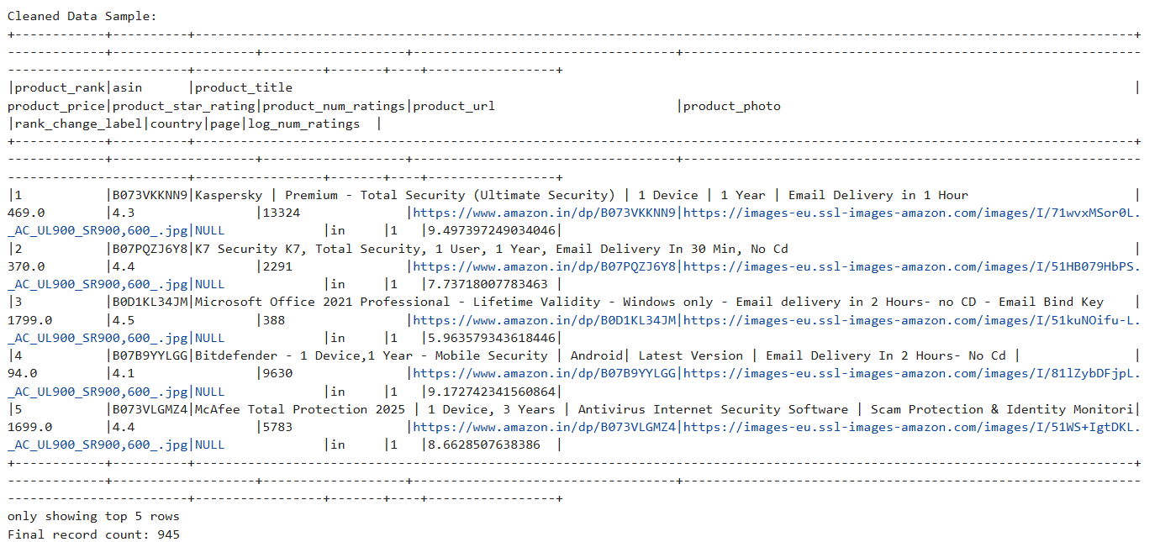
Cleaned Sample Data

Slide 9
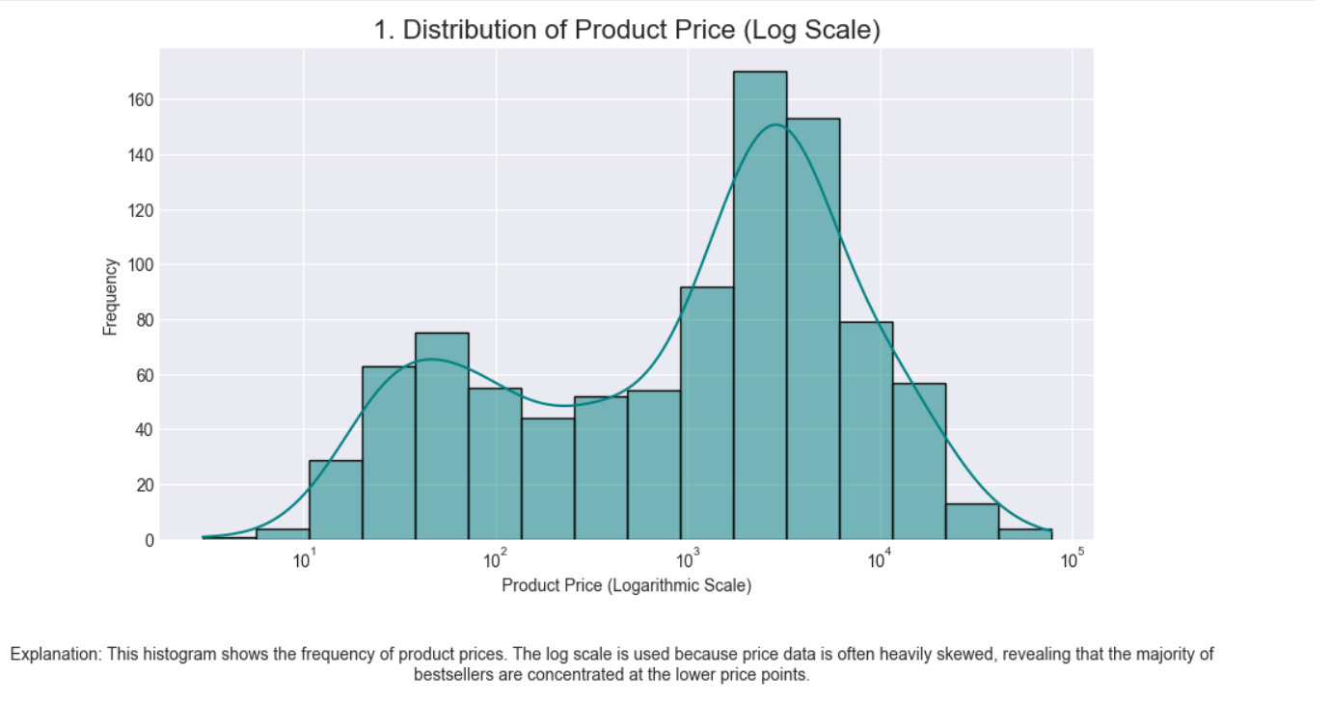
Distribution of Product Price
This histogram shows the frequency of product prices. The log scale is used because price data is often heavily skewed, revealing that the majority of bestsellers are concentrated at the lower price points.

Slide 10
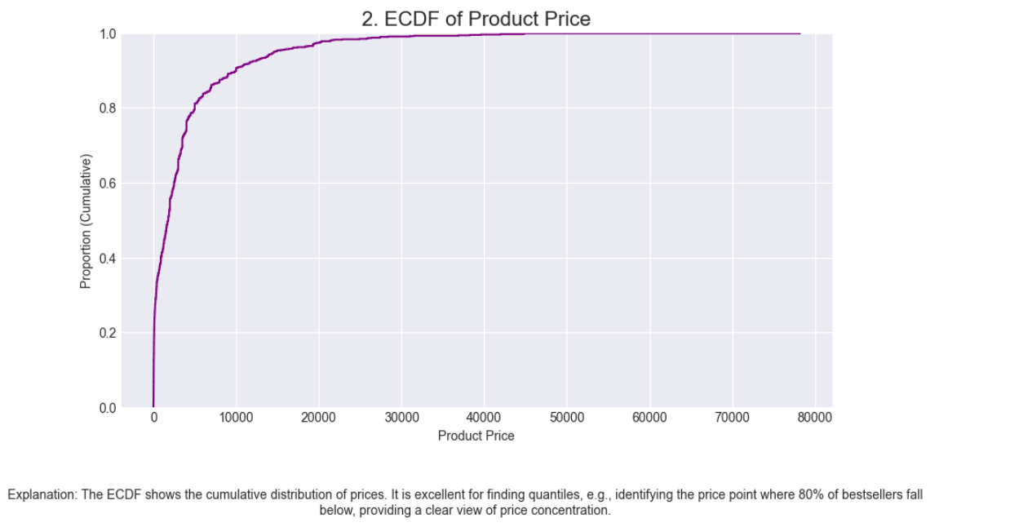
ECDF of Product Price
The ECDF shows the cumulative distribution of prices. It is excellent for finding quantiles, e.g., identifying the price point where 80% of bestsellers fall below, providing a clear view of price concentration.

Slide 11
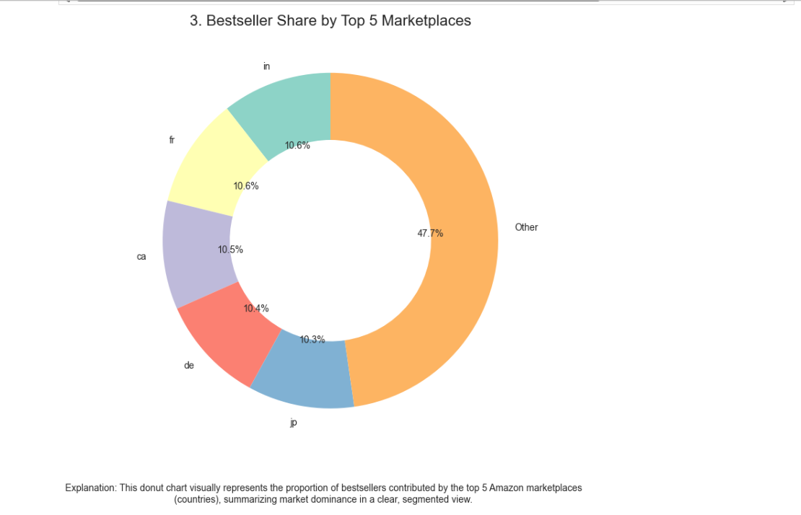
Bestseller Share by Top 5 Marketplaces
This donut chart visually represents the proportion of bestsellers contributed by the top 5 Amazon marketplaces (countries), summarizing market dominance in a clear, segmented view.

Slide 12
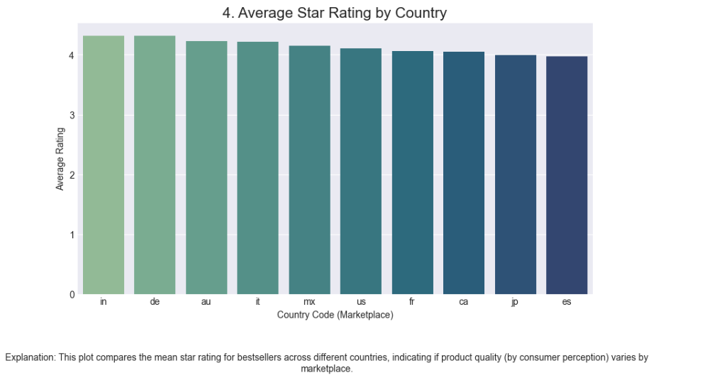
Average Star Rating by Country
This plot compares the mean star rating for bestsellers across different countries, indicating if product quality (by consumer perception) varies by marketplace.

Slide 13
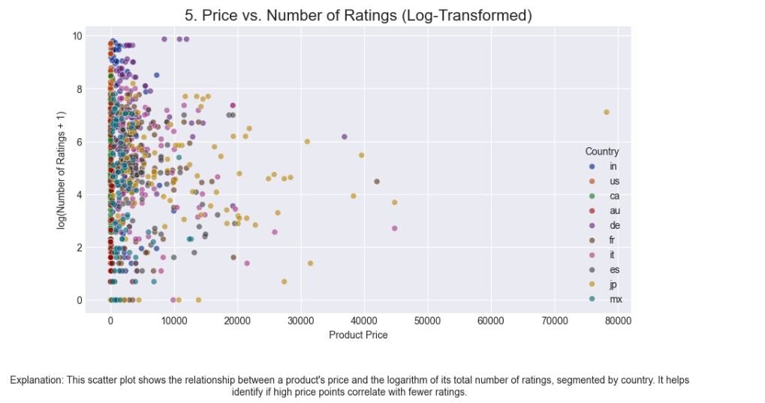
Price vs. Number of Ratings (Log-Transformed)
This scatter plot shows the relationship between a product\'s price and the logarithm of its total number of ratings, segmented by country. It helps identify if high price points correlate with fewer ratings.

Slide 14
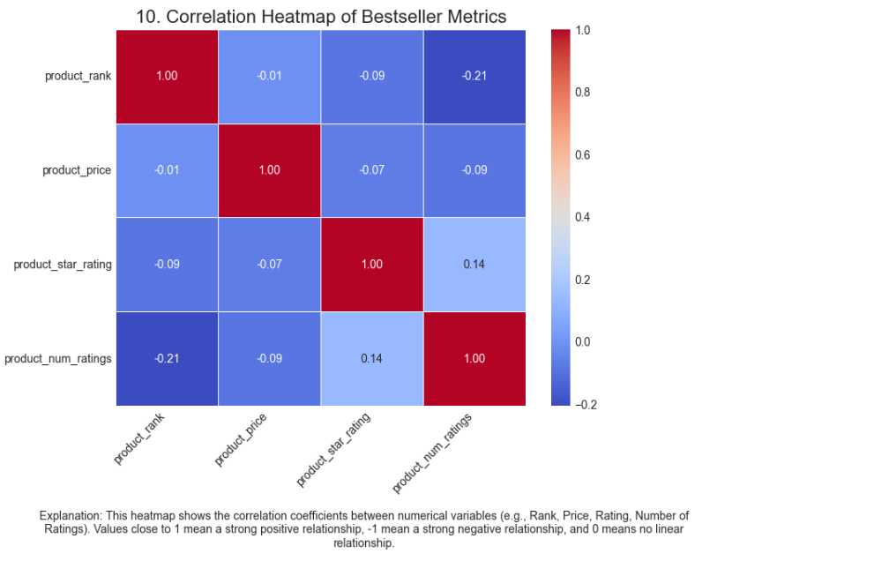
Correlation Heatmap of Bestseller Metrics
This heatmap shows the correlation coefficients between numerical variables (e.g., Rank, Price, Rating, Number of Ratings). Values close to 1 mean a strong positive relationship, -1 mean a strong negative relationship, and 0 means no linear relationship.

Slide 15
Predictive Insights: Exploratory Data Analysis of Amazon Bestsellers.
The analysis confirms that low price and high star ratings are primary predictors of success. The ECDF pinpoints the maximum profitable price ceiling. Moving forward, Predictive Modeling will classify the likelihood of a top-50 rank based on a new product's initial price and rating. Additionally, Text Analysis will predict consumer sentiment and identify the product categories most likely to climb the bestseller charts.
The data strongly suggests that success on the bestseller list is linked to “affordability and high volume of ratings”, with most data points clustered in the low-price range
The uniformly high average star ratings across all bestsellers confirms that quality is a prerequisite for achieving top rank.

